Slide 1
Healthy Churches Pray
1 Timothy 2:1-7
Preached by Dr. Jim Harmeling at Crossroads International Church Singapore • cicfamily.com Uploaded by Dr. Rick Griffith • Singapore Bible College Thousands of files in 49 languages for free at BibleStudyDownloads.org

Slide 3
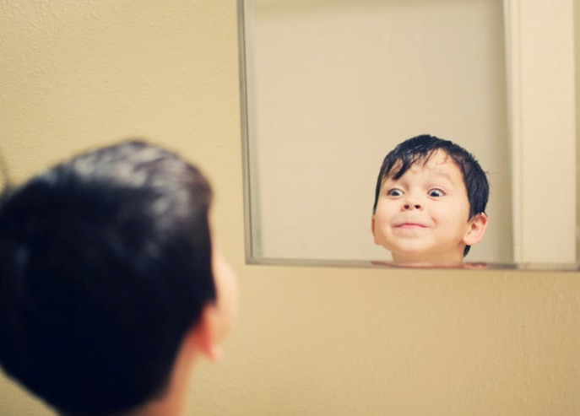

Slide 4
Healthy Church Life
Studies in 1 Timothy

Slide 5
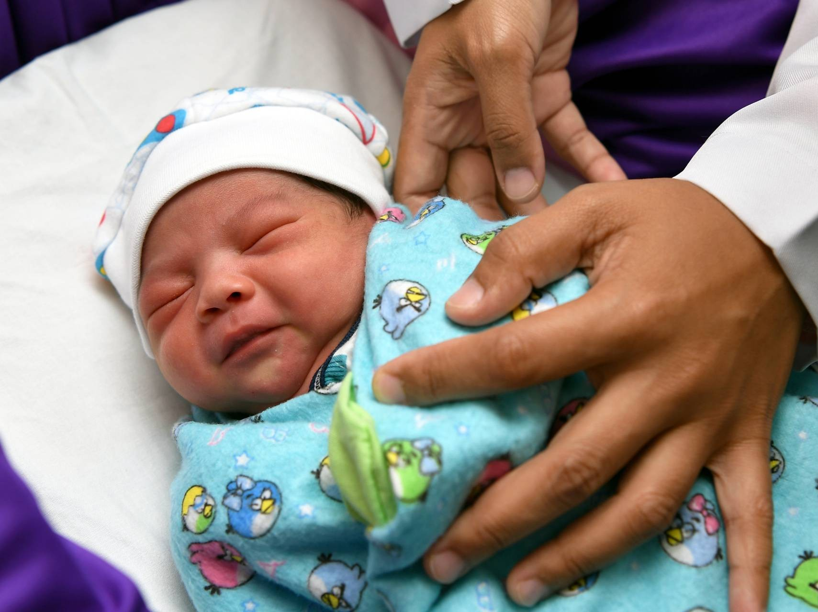
Pray for Gospel Conversions

Slide 6
“entreaties and prayers, petitions
and thanksgivings”
Prayer involves diligent and emotional pleading and earnest begging of God
Prayer involves clear, thought out statements that accord with proper biblical precepts
Prayer involves rejoicing and gratitude over God and His answer to requests

Slide 7
Gospel Inclusive Prayer: pray for everyone’s soul (2:1-4)
This impacts national leaders (v. 1)
This pleases God (v. 3)
This brings people to the truth (v. 4)

Slide 8
Gospel Inclusive Prayer: pray for everyone’s soul (2:1-4)
Gospel Exclusive Prayer: pray for people to embrace the narrow gospel (2:5-7)
There is one God (v. 5a)
There is one mediator to God (v. 5b)

Slide 9
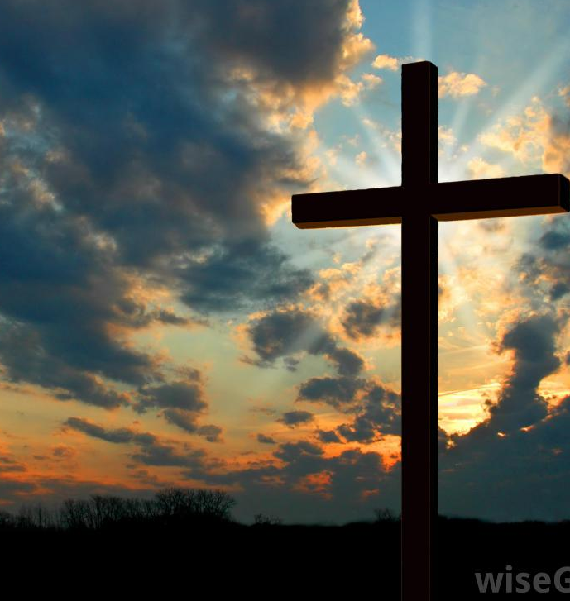
“Paul argues that because there is only one God, all people must be the object of prayer since all can be saved only through the one God and the one mediator.”
William Mounce

Slide 10
¹³ Enter by the narrow gate. For the gate is wide and the way is easy that leads to destruction, and those who enter by it are many. ¹⁴ For the gate is narrow and the way is hard that leads to life, and those who find it are few.
Matthew 7:13-14

Slide 11
Gospel Inclusive Prayer: pray for everyone’s soul (2:1-4)
Gospel Exclusive Prayer: pray for people to embrace the narrow gospel (2:5-7)
There is one God (v. 5a)
There is one mediator to God (v. 5b)
There is one payment for our sin (v. 6a)

Slide 12
For even the Son of Man came not to be served but to serve, and to give his life as a ransom for many.
Mark 10:45

Slide 13
Gospel Inclusive Prayer: pray for everyone’s soul (2:1-4)
Gospel Exclusive Prayer: pray for people to embrace the narrow gospel (2:5-7)
There is one God (v. 5a)
There is one mediator to God (v. 5b)
There is one payment for our sin (v. 6a)
There is one time that payment was made (v. 6b)

Slide 14
But when the fullness of time had come, God sent forth his Son, born of woman, born under the law.
Galatians 4:4

Slide 15
Gospel Inclusive Prayer: pray for everyone’s soul (2:1-4)
Gospel Exclusive Prayer: pray for people to embrace the narrow gospel (2:5-7)
There is one God (v. 5a)
There is one mediator to God (v. 5b)
There is one payment for our sin (v. 6a)
There is one time that payment was made (v. 6b)
There are commissioned messengers to proclaim this truth (v. 7)

Slide 17
NT Preaching • BibleStudyDownloads.org
Get this presentation for free!

